Slide 1
Reactive Extensions
Push your data
By
Grzegorz Jachimko

Slide 2
But before we start…
Processor → 1 cycle ~= 1 second
Do we want our resources to idle?
Read register
1s
Read memory
5-10s
Read from magnetic HDD
~ 3 miesięcy
Read from network
~ 30 lat

Slide 3
Threading hidden costs
Almost any modern OS supports multithreading – 1+ threads / process, to enable multitasking
But… threads are not for free:
kernel data – (thread properties, space for registers, 1-3 KB)
Stack – private thread memory to keep track of the execution and storage of the local variables (primitive ones) – depending on the settings – between 100 KB – 1 MB
Context switching

Slide 4
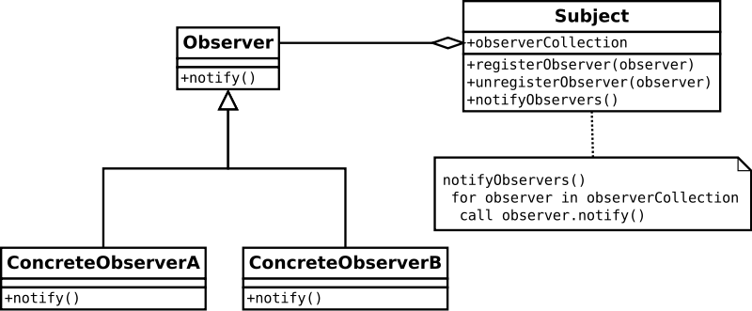
RX – it is all about the Observer
http://http://en.wikipedia.org/wiki/Observer_pattern

Slide 5
Observer in java
Two (or three) basic interfaces:
interface Emitter<T>
{
void onNext(@NonNull T item);
void onCompleted();
void onError(@NonNull Throwable err);
}
interface FlowableEmitter<T> extends Emitter<T> { … }
interface Flowable<TResult> extends Publisher<TResult>
{
void | Disposable subscribe(…)
}
It is all about „push” vs „pull” model…

Slide 6
RX concurrency
Out of the box – RX is NOT using threads
(there are some exceptions though – Timer, Interval)
RX will execute code on any given thread
Wait! – this doesn’t sound right, does it?
Subscription thread – subscribeOn
Observation thread – observeOn
Flowable<T> sequence = …;
sequence .subscribeOn(Scheduler) .observeOn(Scheduler) .Subscribe()

Slide 7
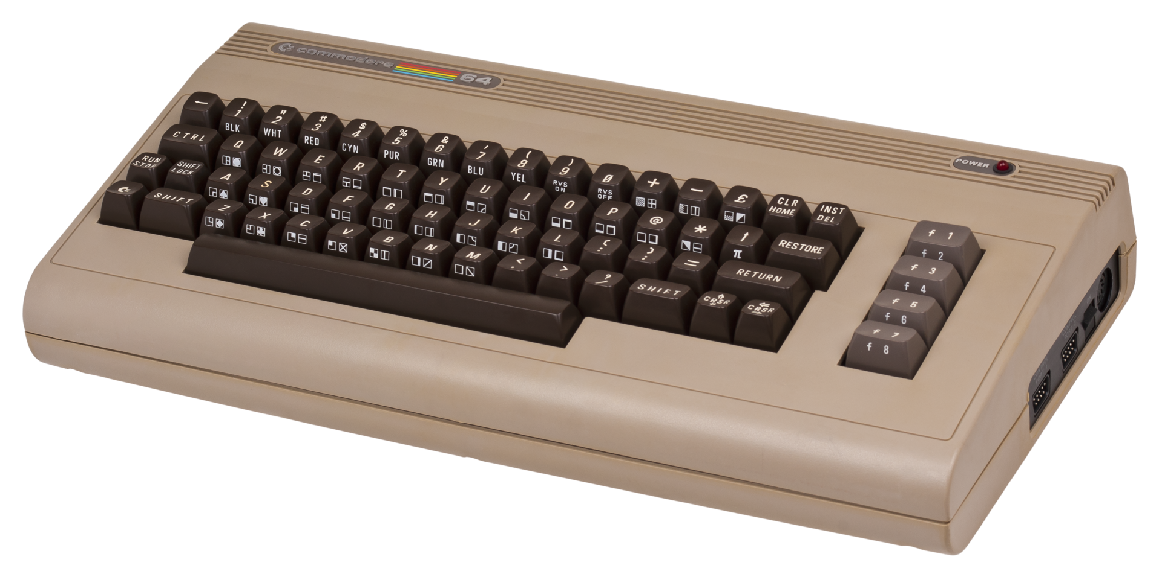
Demo!

Slide 8

Lets have a look at the details - Flowable
Simple interface - Disposable subscribe(…)
Why bother with disposable?
How about…
Exception handling?
Completition?

Slide 9
Lets have a look at the details - Emitter
Yet another simple interface…
onNext
onCompleted
onError
How do we create them?
Factory methods!!! – just, deffer, create
Some other handy methods
empty
throw
never
From futures
From collections (iterables and arrays)
From callables

Slide 10
Demo!

Slide 11

I’ve heard something about Subjects…
What a subject is?
Subject types:
Subject<T>
ReplaySubject<T>
BehaviourSubject<>
AsyncSubject<T>
How and when to use them?

Slide 12
Demo!

Slide 13
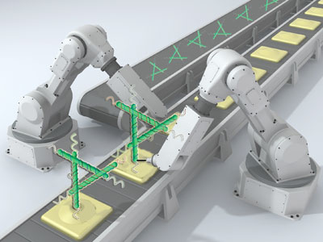
Sequence manipulation
It is almost as simple as with stream API!
filter
distinct / distinctUntilChanged
skip / take
skipWhile / skipUntil / takeWhile / takeUntil
There is some extra flavour to:
count, all, any
I said almost „like”, because there are:
blockingXYZ

Slide 14
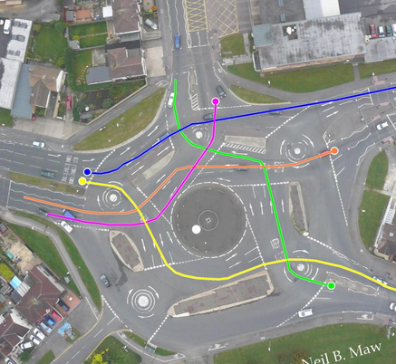
What if I want to aggregate?
Nothing fancy– use following:
compose
scan
groupBy

Slide 15
Demo!

Slide 16

And there are also nested seqences
Sequence of a sequence
Flowable<Flowable<T>> what is this?
Let’s say – whenever I type a partial postal code, I’d like to get instant auto suggestion of all matched cities…
This translates to:
0 → Warszawa, Dąbrowa, Wiśniowo, Szydłowo
02 → Warszawa, Miława,
02-1 → Warszawa

Slide 17

How to understand it?
An image is worth 1.000 words…
Sequence is a horizontal line
Time moves to the right
Notification is one of:
OnNext = 0
OnCompleted = |
OnError = X
So:
0-0-0-| sequence completed with 3 elements
0-X sequence completed with error after producing value
-| empty sequence
--- sequence which didn’t complete nor produced anything

Slide 18

So going back to the example…
- - 0 - - - - - - - - - - - - - - 0- - - - - - - - - - - 0 - - - - -
(0) (02) (02-1)
---------0-------0-------------0-----------------0-I
(Warszawa) (Dąbrowa) (Wiśniowo) (Szydłowo)
--------0---------0--------I
(Warszawa) (Miłowa)

Slide 19

What do I do with it?
Combine!
merge
switch
amb
zip
combineLatest
concat
startWith

Slide 20
Yet another demo!

Slide 21
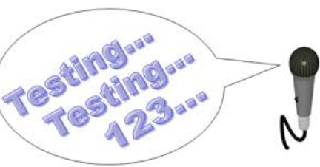
What about testing?
RX supports testing out of the box!
Use TestScheduler
AdvanceBy
AdvanceTo

Slide 22
And short testing demo

Slide 23

Some control flow instructions
using
onErrorReturn
doFinally
retry
repeat
delay
Timeout
parallel / sequential

Slide 24
That’s pretty much, when it comes to basics….
Thanks for your attention!
If you have questions –
grzegorz.jachimko@tomtom.com

